Slide 1
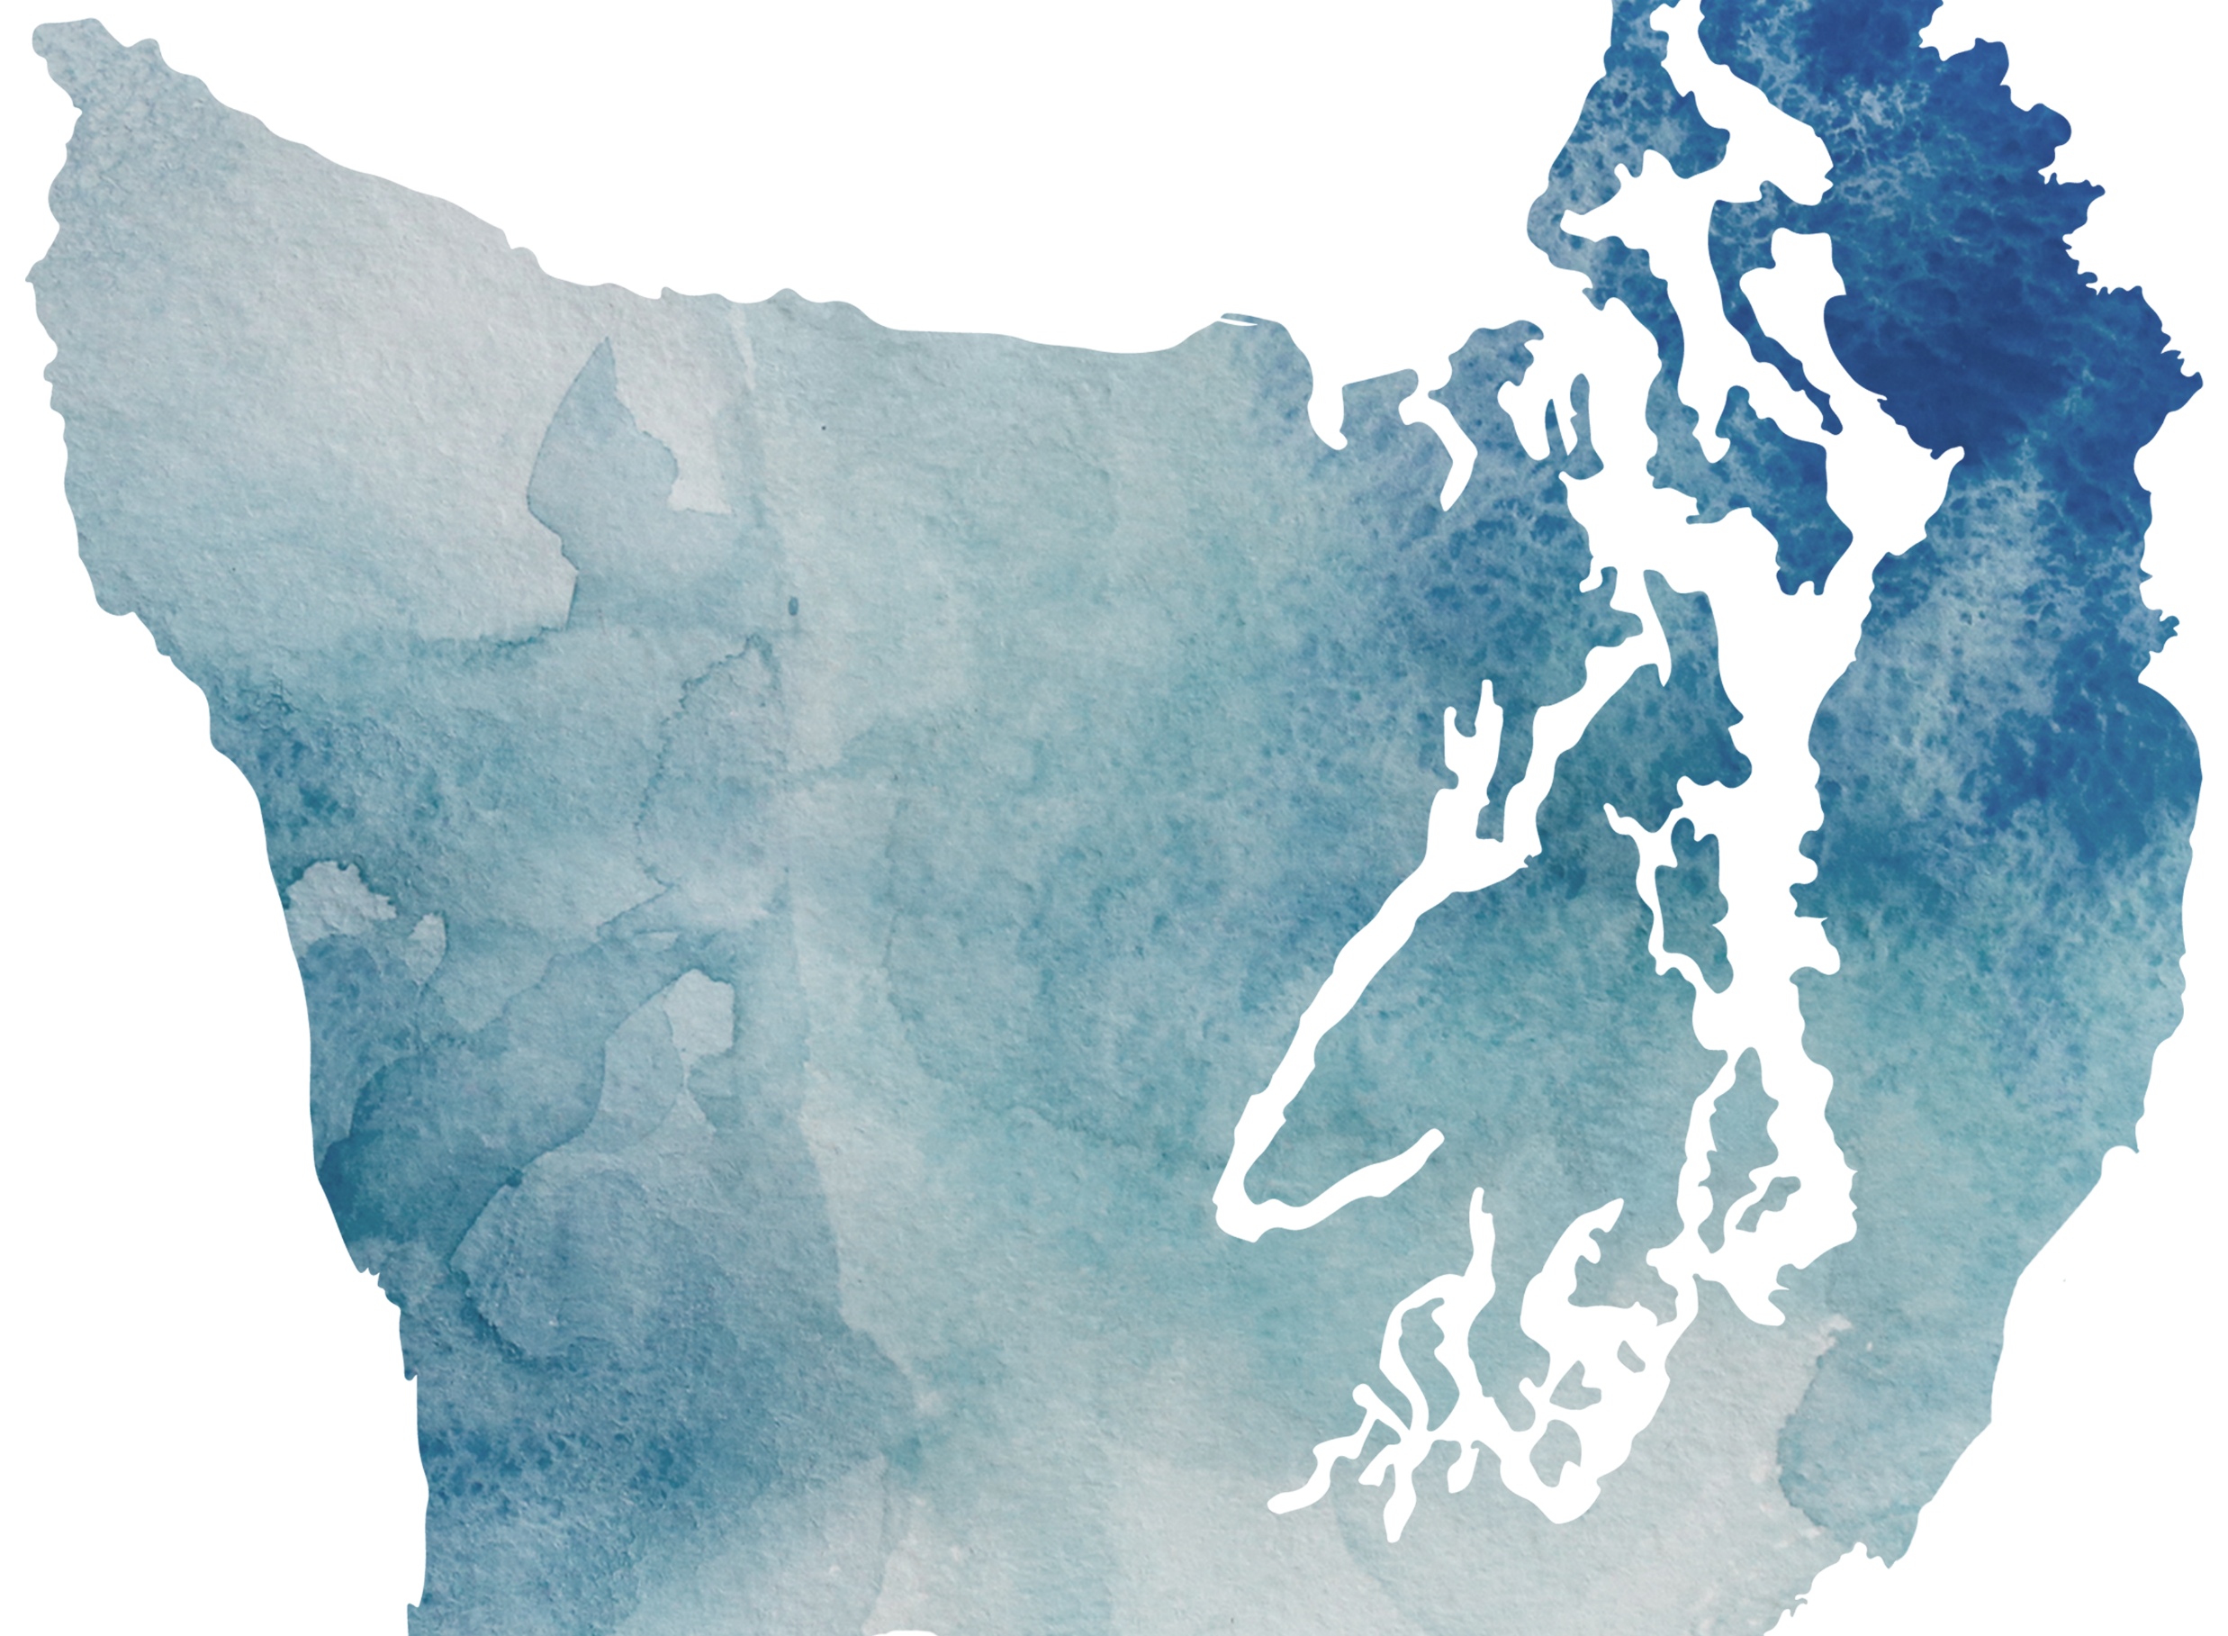
Olympic Region
Equity Community of Practice
October 31, 2023
Clallam | Jefferson | Kitsap

Slide 2
Purpose
To bring Olympic region partners and Tribes together to collectively address and advance equity through shared learnings, best practices, and a shared vision of a healthier, more equitable region.

Slide 3
Objectives
Establish a shared understanding of "equity."
Establish a shared understanding of "community of practice."
Foster an inclusive, supportive, kind space for learning.

Slide 4
Norms
Please introduce yourself when you speak
Be present…bring your full attention to the process. Acknowledge anything that you need to let go of in order to be present.
Try on new perspectives…be willing to open up to new territory and break through old patterns. Remember, “try on” is not the same as “take on.”
It’s OK to disagree…avoid attacking, discounting, or judging the beliefs and views of others. Instead, welcome disagreement as an opportunity to expand your world.
Confidentiality…it helps to remember that the story belongs to the teller.
Make space, take space…be aware of sharing space in the group. Respect the different rhythms in the room; it is ok to be with silence.
Adapted from Guidelines for Multicultural Interactions by Laurin Mayeno and Elena Featherston, 2006

Slide 5
Norms -continued
Self-awareness…respect and connect to your thoughts, feelings, and reactions in the process. Monitor the content, the process and yourself.
Check out assumptions…this is an opportunity to learn more about yourself and others; do not “assume” you know what is meant by a communication especially when it triggers/activates you. Ask questions.
Practice “both/and” thinking…making room for more than one idea at a time means appreciating and valuing multiple realities.
Intent is different from impact…and both are important. It is also important to own our ability to have a negative impact on another person’s life despite our best intention.
Listen deeply…listen with intent to hear, listen for the entire content and what is behind the words. Engage heart and mind, listen with alert compassion.
Speak from the “I”…is speaking from one’s personal experience rather than saying “we,” it allows us to take ownership of thoughts, feelings, and actions.
Adapted from Guidelines for Multicultural Interactions by Laurin Mayeno and Elena Featherston, 2006

Slide 6
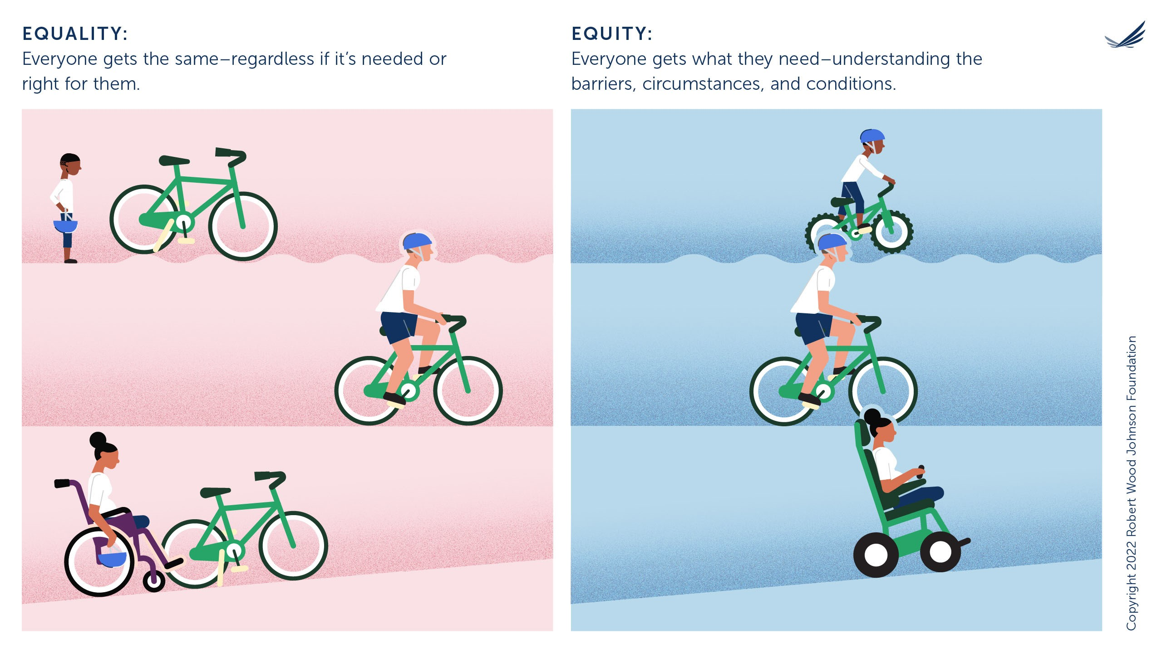
"Equality" or "Equity"?

Slide 7
"Equality" or "Equity"? -continued

Slide 8
In response to registration question: What does "equity" mean to you?
Participants shared answers in advance of event. Word cloud generated from responses.

Slide 9
Defining "equity" for this community of practice:
“Everyone gets what they need to have access and opportunity. Those that have been marginalized and oppressed are acknowledged and supported to gain this access and opportunity. Getting what you want. Voice encouraged. Intersectional identities acknowledged.”
“Everybody for the next seven generations and beyond has access to power, opportunities, and resources to flourish. With acknowledgement and validation comes belonging. We cannot have equity without justice.”
“Equity- when we are aware of differences, which result in having a community that has what they need to thrive, reduces barriers to medical services.”
“Equity- taking a holistic approach, equity is being treated fairly, and having the same opportunity to have resources and support with inclusion needed to thrive.”
“Equity- a process that restructures power imbalance to grant access so people are empowered to thrive.”
Responses gathered from small groups during event.

Slide 10
TRIZ- the Power of Creative Destruction
What is made possible when we clear room for innovation?
What must we STOP doing in order to make progress on our deepest purpose?
Using TRIZ (Theory of Inventive Problem Solving) we took time to examine the counterproductive behaviors, mindsets, practices, and procedures that contribute to inequitable environments.
List all the ways we can ensure we are creating the most INEQUITABLE environment possible.
Be brutally honest. What are we doing that resembles anything on list #1?
What is the first step we can take to STOP what we have identified on list #2?
"The urge to destroy is also a creative urge" - Mikhail Bakunin
Source: https://www.liberatingstructures.com/6-making-space-with-triz/

Slide 11
TRIZ- the Power of Creative Destruction -continued
Inspiring solutions and promising first steps to disrupt inequitable environments:
Test processes with fresh eyes
Step up, be the voice challenging inequity
Reflection as a community and individually
This work start from within- self monitoring
Seek input from women, Black, Indigenous, and People of Color voices
Listen deeply
Utilize Trauma Informed Care, accountability, and slowing down
Expand social sphere- listen more, practice asking questions
Hold brave spaces for conversations
Responses gathered from participants during event.

Slide 12
What is the value of a "Community of Practice“ for the participant?
Short Term Value:
Participant
Assist with challenges
Access to expertise
Confidence
Fun with colleagues
Meaningful work
Long Term Value:
Participant
Personal development
Reputation
Collaborative advantage
Source: https://www.slideshare.net/Celcius233/a-guide-to-communities-of-practice

Slide 13
What is the value of a "Community of Practice“ for community partners?
Short Term Value:
Community Partners
Problem solving
Time saving
Knowledge sharing
Synergies across units
Reuse of resources
Long Term Value:
Community Partners
Strategic capabilities
Innovation
Retention of talents
New Strategies
Source: https://www.slideshare.net/Celcius233/a-guide-to-communities-of-practice

Slide 14
What are the functions of a "Community of Practice"?
Filtering
Amplifying
Investing and Providing
Convening
Community Building
Learning and Facilitating
Organizing and managing information that is work paying attention to
Taking new, little-known or little understood ideas, giving them weight and making them more widely understood
Bringing together different, distinct people or groups of people
Offering a means to give members the resources they need to carry out their main activities
Promoting and sustaining collective values and standards
Helping members carry out their activities more efficiently and effectively
Source: https://www.slideshare.net/Celcius233/a-guide-to-communities-of-practice

Slide 15
What are the success factors of a "Community of Practice"?
Community
A space that energizes the core group
Skillful and reputable managers and facilitators
Involvement of participants
The details of practice are addressed
Right rhythm and mix of activities
Function
Clearly defined function
Capacities, skills, resources, and systems match function
Organization
A mix of formal and informal structures
Adequate resources
Shared understanding
Source: https://www.slideshare.net/Celcius233/a-guide-to-communities-of-practice

Slide 16
What are the success factors for Olympic Region Equity Community of Practice?
Community
Rotating online and in-person meetings
Intentional rhythm, 3 per year with one in each county (Tribal spaces preferred)
Finding common ground across counties
Diverse participants engaged in this work
Function
Opportunities to learn from others
Equitable languages
Funding/investment for resources to try new things
Accountability
Trauma Informed Care
Organization
Sourcing funding for this time
Take away resources to share back with teams
Shared understanding, language and identify starting place
Share mission, vision, purpose, intention
Balance of formal and informal structures- more time to think
Generative prompts with reflection time
Responses gathered from small groups during event.

Slide 17
Final Reflections
One word to describe how you feel leaving this space:
Motivated
Curious
Grateful
Hopeful
Inspired
Mindful
Reflective
Energized
Destructive (in a good way)
Nervous (in a good way)
Something you are taking away from today:
New community connections
Collaborative approaches
New perspectives
TRIZ- creative destruction activity
Uplifting coloring page
Responses gathered from participants during event.

Slide 18
Join us!
Interested in attending the next
Olympic Region Equity Community of Practice?
Email OCH@olympicch.org
Sign up for Olympic Community of Health’s newsletter to stay up to date on upcoming events in 2024 – sign up here

Slide 19
Thank you

